Slide 1
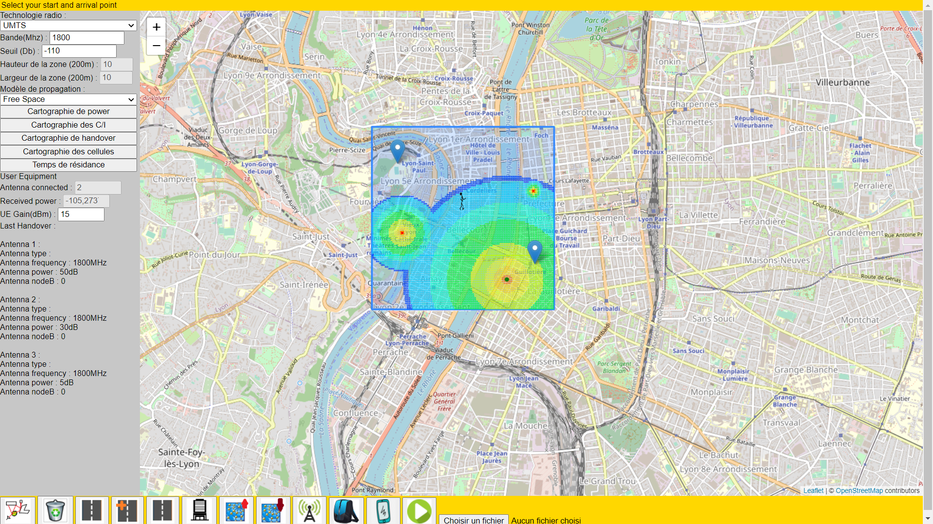
Cell Selection
Notes:
Se presenter + nos profils

Slide 2


Table of contents
I – Introduction
II – Theorical researches
1) Free space propagation
2) Handover
III – Implementation
1) Global architecture
2) Movement implementation
3) Selection process
4) Handover
IV – Demo
V – Conclusion

Slide 3
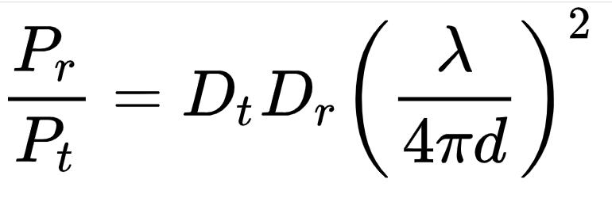
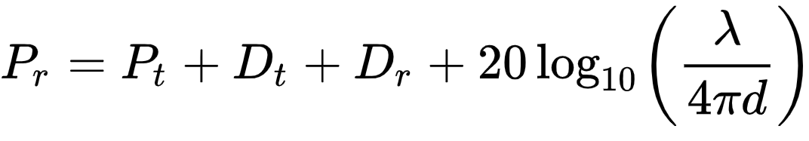
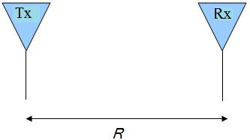
II – Theorical researches
1) Free space propagation
Linear
Logarithmic

Slide 4
III – Implementation
1) Global architecture
Objectives :
set a group of antennas
set a UE path
accomplish this path while observing
UE and antenna connectivity

Slide 5
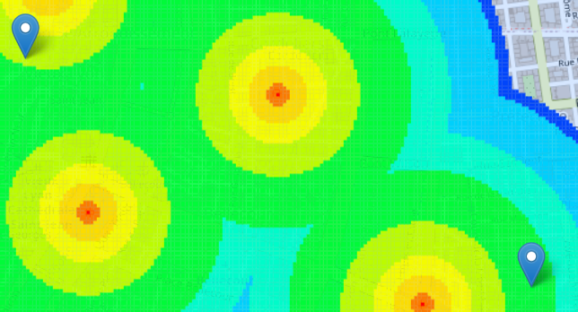

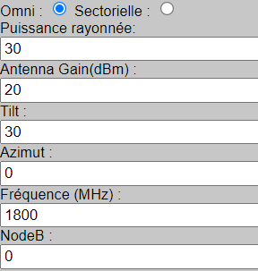
III – Implementation
1) Global architecture
User Equipment
parameter initialization
UE path initialization
Antenna initialization
Notes:
Protection system to avoid clicking a button before another one has been clicked
Dynamic menu
Calcul of the power matrice

Slide 6
III – Implementation
1) Global architecture
Simulation loop (every ?? ms) :
calculate next position
apply Handover
set UE menu
set antenna menu
set UE on the map
set connected antenna on the map

Slide 7
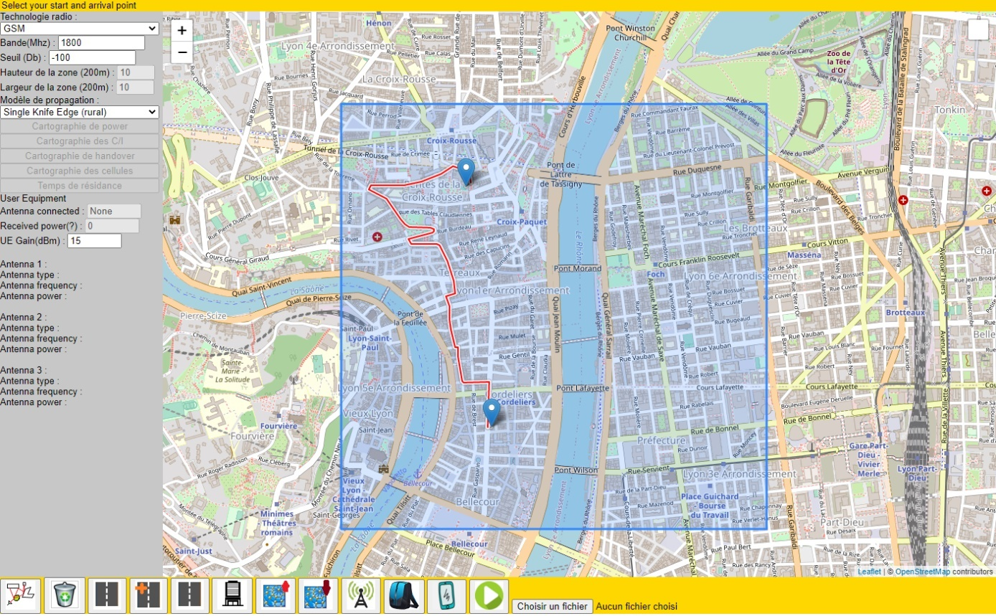
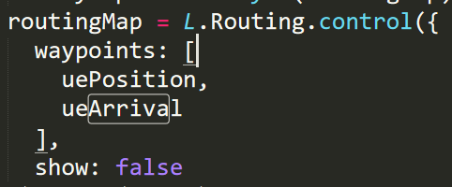
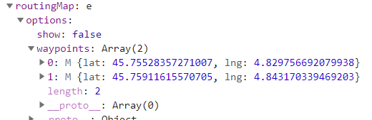
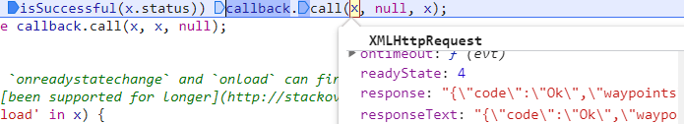
III – Implementation
2) Movement implementation
Notes:
4 methods 2 working

Slide 8
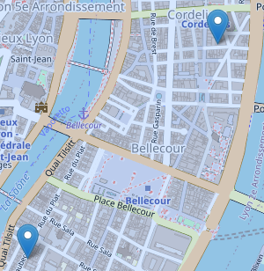


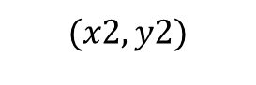
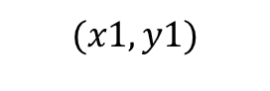

III – Implementation
2) Movement implementation
$$\sqrt{{\left(x2−x1\right)}^{2}+\left(y2−y1\right)²}=Z$$
$$(x2,y2)$$
$$f\left(x\right)=ax+b$$
$$(x1,y1)$$
Notes:
4 methods 2 working

